Slide 1

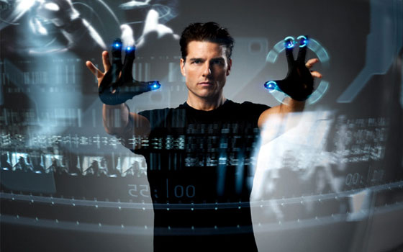
Human-computer interface with Kinect
Institute of Information and Communication Technologies
by Alexander Marinov

Slide 2



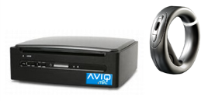

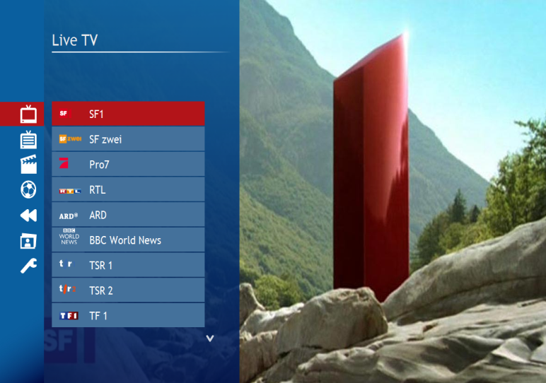
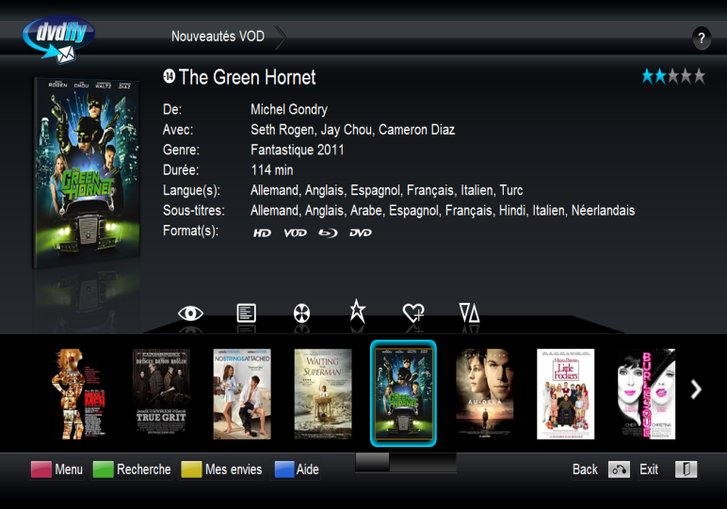

My professional work

Slide 3

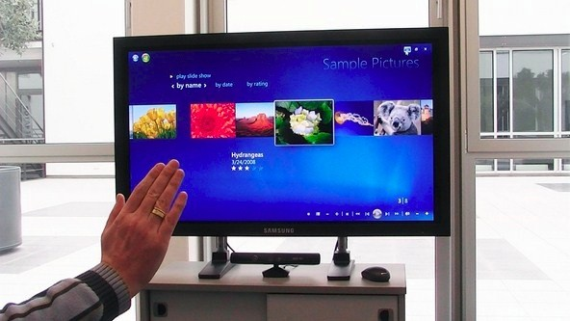
My scientific work

Slide 4
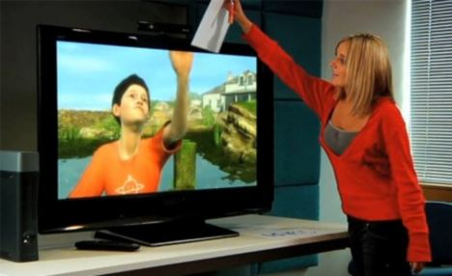
Motivation
Meet Milo an on-screen computer character which uses Kinect "Project Natal" to interact intelligently with humans. Narrated by Peter Molyneux of Lionhead Studios.

Slide 5
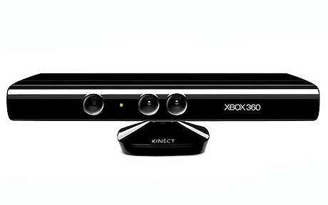
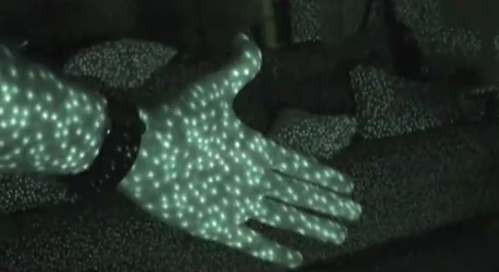
Depth cameras
Sensor
Color and depth-sensing lenses
Voice microphone array
Tilt motor for sensor adjustment
Field of View
Data Streams
320x240 16-bit depth @ 30 frames/sec
640x480 32-bit colour@ 30 frames/sec
16-bit audio @ 16 kHz
Horizontal field of view: 57 degrees
Vertical field of view: 43 degrees
Physical tilt range: ± 27 degrees
Depth sensor range: 1.2m - 3.5m

Slide 6
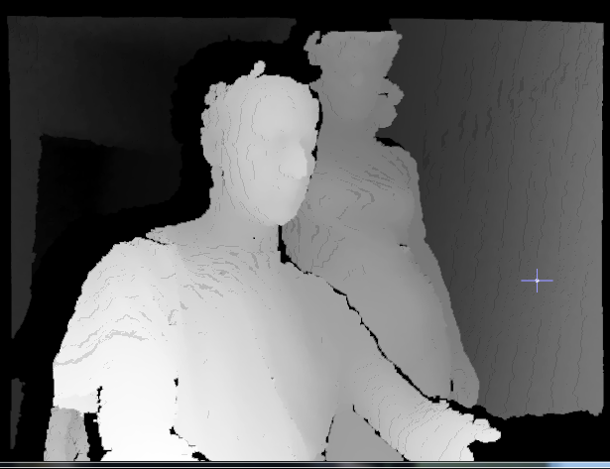
Depth images
D
Y
X

Slide 7
Framework
• Locate people in the scene, ignore background
• Locate their limbs and joints, which person is which
• Find and track their gestures
Demonstration!

Slide 8
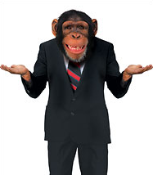

Problem
• Map the gestures to meaning and commands
• What is a gesture
• How to recognize gesture

Slide 9
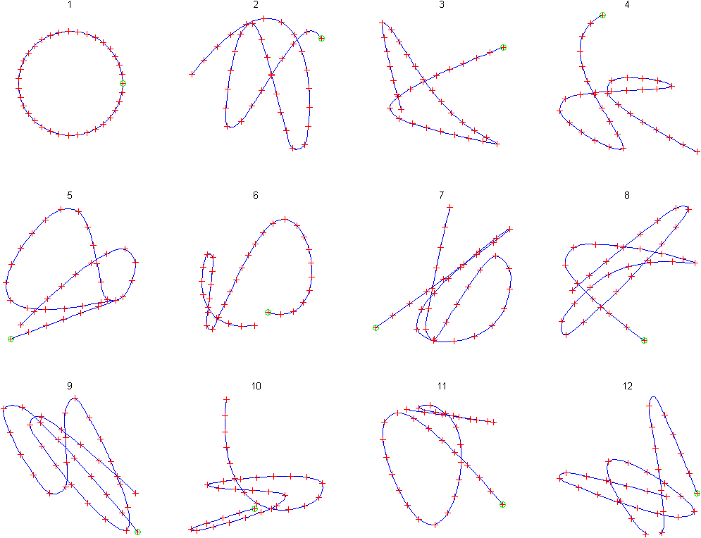
Gestures
• Point set trajectory of one or more human body parts

Slide 10
Gesture recognition
Euclidean Distance
Sequences are aligned “one to one”.
Dynamic Time Warping
Nonlinear alignments are possible.
Gavrila, D. M. & Davis,L. S.(1995). Towards 3-d model-based tracking and recognition of human movement: a multi-view approach. In IEEE IWAFGR

Slide 11
How is DTW Calculated?
γ(i,j) = d(q_{i},c_{j}) + min{ γ(i-1,j-1) , γ(i-1,j ) , γ(i,j-1) }
C
Q
C
Q
Warping path w

Slide 12
DTW: Example 1
1
5
5
3
4
2
2
∞
2
5
5
2
2
1
3
∞
3
4
4
2
1
2
5
∞
2
∞
2
2
1
2
2
4
1
∞
1
1
2
4
5
6
1
∞
1
1
2
4
5
6
0
∞
1
2
4
7
9
9
Q
0
∞
∞
∞
∞
∞
∞
1
1
2
3
2
0
C
DTW(Q,C)=

Slide 13
DTW: Example 2
1
5
3
4
2
2
2
∞
2
5
2
2
1
3
4
∞
3
4
2
1
2
5
6
∞
2
∞
2
1
2
2
4
5
1
∞
1
2
4
5
6
6
1
∞
1
2
4
5
6
6
0
∞
1
3
6
8
8
9
Q
0
∞
∞
∞
∞
∞
∞
1
2
3
2
0
1
C
DTW(Q,C)=

Slide 14
DTW: global path constraints
Sakoe-Chiba Band
Itakura Parallelogram

Slide 15
DTW: Lower Bounds optimization
We can speed up similarity search under DTW by using a lower bounding function.
Algorithm Lower_Bounding_Sequential_Scan(Q)
best_so_far = infinity;
for all sequences in database
LB_dist = lower_bound_distance(Ci, Q);
endfor
if LB_dist < best_so_far
true_dist = DTW(Ci, Q);
endif
if true_dist < best_so_far
best_so_far = true_dist;
index_of_best_match = i;
endif

Slide 16
DTW: Lower Bound of Kim et. al.
C
A
D
B
The squared difference between the two sequence’s first (A), last (D), minimum (B) and maximum points (C) is returned as the lower bound
Kim, S, Park, S, & Chu, W. An index-based approach for similarity search supporting time warping in large sequence databases. ICDE 01, pp 607-614

Slide 17
DTW: Lower Bound of Yi et. al.
max(Q)
min(Q)
The sum of the squared length of gray lines represent the minimum the corresponding points contribution to the overall DTW distance, and thus can be returned as the lower bounding measure
Yi, B, Jagadish, H & Faloutsos, C. Efficient retrieval of similar time sequences under time warping. ICDE 98, pp 23-27.

Slide 18
Summary
• We use Microsoft ® Kinect ™ and existing SDK to obtain human body parts gesture trajectories
• We apply Dynamic Time Warping algorithm to match the closest gesture from a database
• Trigger command to the device corresponding to the matched gesture

Slide 19
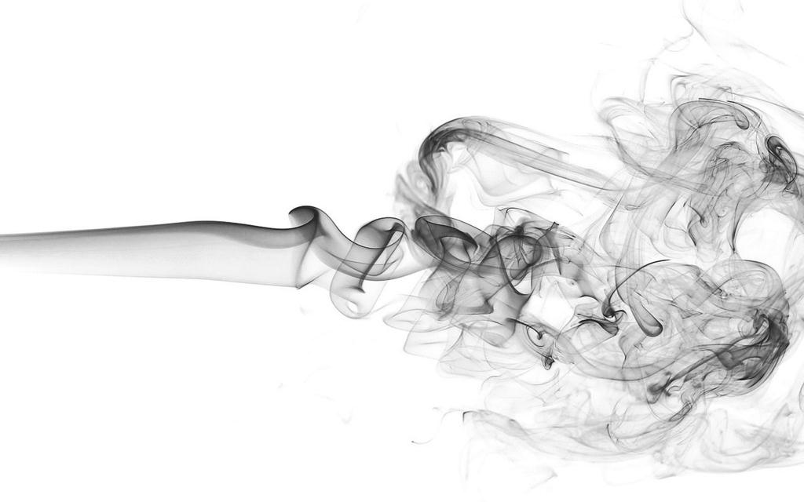
Thank you!

